Slide 1
Sounding Rocket Structural Loads
C. P. Hoult

Slide 2
Motivation
Why are structural loads important?
  Structural loads are needed to estimate stresses on structural elements
  Stress analyses tell us whether or not an element would fail in service
Since many sources of sounding rocket structural loading are statistical, it’s necessary to think in terms of the probability that an element would fail in service
Keep in mind that it’s often necessary to iterate a design to obtain adequate strength and stiffness without excessive weight

Slide 3
Loading Conditions
Loading conditions are associated with a trajectory state and event at which maximum loading on a(n) element(s) might occur
  Selected using engineering judgment
For our 10 k rocket, these conditions might include
  Burnout/maximum dynamic pressure/maximum Mach number (these events happen more or less simultaneously)
  Drogue parachute deployment
  Maximum pressure difference …(internal – external) pressure
  Ground impact
The first three are amenable to analysis; the fourth must be addressed empirically
  BENDIT (the focus of these charts) addresses only the first two
  BLOWDOWN computes pressure difference

Slide 4
Burnout Flight Loads
Flight experience suggests that this condition is the most important one for most structural elements
Mass
Rocket behaves like a rigid
second order mass, spring &
dash pot system
Damping (the dash pot) is
positive, but negligibly small
Therefore, rocket is
dynamically stable
All perturbations will cause the
rocket to oscillate in angle of
attack as though there were an
axle through the C.G.
Maximum air loading occurs at
the peak of the angle of attack
oscillation
Spring
Dash Pot
(lift centroid)
CP
CG
(mass centroid)

Slide 5
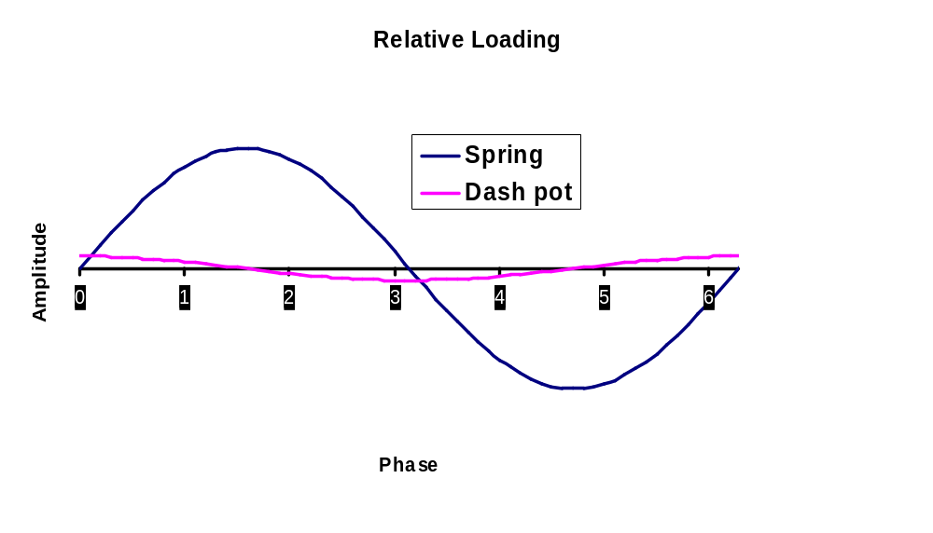
Relative Loading
Plot the relative amplitude of the “spring & inertia” and “dash pot” loads over one pitch cycle
Damping loads –shown as 10% of spring loads – have been exaggerated in the plot
Maximum load conditions indicated by arrows

Slide 6
Body Elements
+S_{i+1}
Consider the body to be composed of a sequence of body elements
  Element boundaries often are located at bulkhead stations
A free body diagram for the i^{th} element looks like
+M_{i}
+S_{i}
+M_{i+1}
+S_{i+1}
+S_{i}
+M_{i+1}
C_{Nαi}
C_{Nαi}
x_{CPi}
C_{Nαi}q S_{ref}α
x_{CGi}
+M_{i}
+S_{i}
+M_{i+1}
+x
+S_{i+1}
+z
x_{i}
Nose tip
+z
Nose tip
Notation
  x_{i} = Forward body station of the element
  x_{CGi} = Element CG body station
  x_{CPi} = Element CP body station
  S_{i} = Shear force acting at body station x_{i}
  M_{i} = Bending moment acting at body station x_{i}
  C_{Nαi} q S_{ref} α = Aerodynamic normal force acting on the element
+x
+x
+z
x_{i}
+z
x_{i}

Slide 7
Body Elements, cont’d
More notation
  q = Dynamic pressure
  S_{ref} = Aerodynamic reference area
  U = flight speed
  α = Angle of attack
  m_{i} = Mass of the i^{th} element
  X_{CG} = Body station of CG of the entire rocket
  A_{Z} = z axis normal acceleration of the rocket CG
  C_{Nai} = Normal force coefficient slope of the i^{th} element
Sum forces in the z direction:
S_{i+1} – S_{i} – q S_{ref} C_{Nαi} α = m_{i} (A_{Z} – (X_{CG} – x_{CGi}) d²α/dt²)
If A_{Z}, X_{CG}, d²α/dt² & S_{i} are known, find S_{i+1}, and then march from nose (S₁ = 0) to the tail
α
U
x

Slide 8
Body Elements, cont’d
Rocket CG:
X_{CG} = ∑ m_{i} x_{CGi} / ∑ m_{i}
Normal acceleration:
A_{Z} = – q S_{ref} α ∑ C_{Nαi} / ∑ m_{i}
Sum the torques about the element CG:
M_{i} – M_{i+1} + S_{i} (x_{CGi} – x_{i}) + S_{i+1} (x_{i+1} – x_{CGi}) + q S_{ref} C_{Nαi} α (x_{CGi} – x_{CPi})
= J_{i} d²α /dt²
More notation:
  J_{i} = Pitch moment of inertia of the ith element about its CG
  I_{YY} = Pitch moment of inertia of the entire rocket
Find I_{YY} from parallel axis theorem:
I_{YY} = ∑ J_{i} + m_{i} ( X_{CG} – x_{CGi})²

Slide 9
Body Elements, cont’d
Last equation needed is that for the rigid body pitch motion
I_{YY} d²α/dt² = q S_{ref} α ∑ C_{Nαi} (X_{CG} – x_{CPi})
Finally, regard α as the key driving variable
  If the shear force and bending moment vanish at the nose tip
  S₁ = M₁ = 0,
  Then given α, a marching solution is easy to construct in BENDIT
  Start by computing X_{CG}, I_{YY}, A_{Z} and d²α/dt²
  Then find S₂ and M₂, then S₃ and M₃, etc.
  Don’t forget to check that S and M vanish at the aft end!

Slide 10
Fin Loading
N_{F}
Estimate loading normal to the plane of a fin with strip theory
Local angle of attack of a strip of fin (with body upwash) is
Airfoil
U
α_{local}
ω_{R}
α_{local} = α (1 + (R/y)² ) + δ_{F} – ω_{R} y/U
Aerodynamic normal force N_{F} acting on a strip
N_{F} = q c(y) δy C_{NαF} α_{local}
More notation
  δ_{F} = Fin cant angle
  ω_{R} = Roll rate
  y = Distance from rocket centerline to the strip
  R = Body radius
  c(y) = Chord of the strip at spanwise station y
  δy = Span of the strip
  C_{NαF} = Fin panel normal force coefficient slope (without
  interference)…not an airfoil C_{Nα}

Slide 11
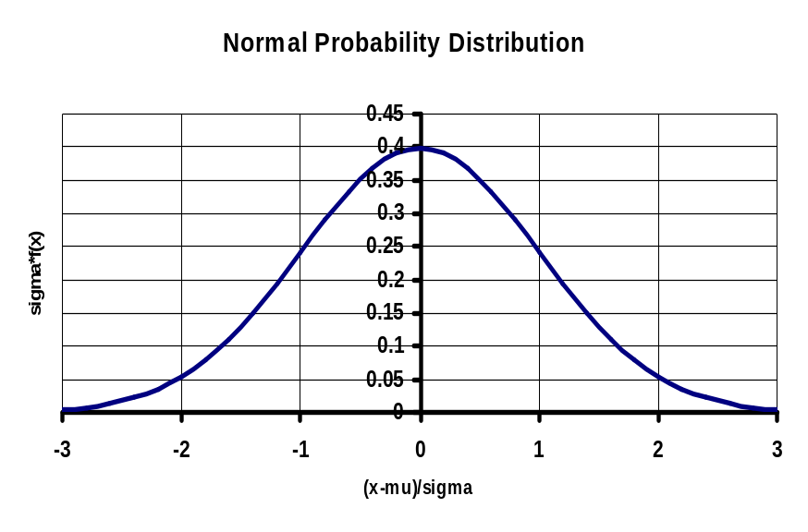
A Statistics Mini-Tutorial
Cause & Effect
  When an effect (an event) is due to the sum of many small causes, the effect’s probability distribution is often normal or gaussian (a bell curve)
  This is the famous Central Limit Theorem
  f(x) =
Normal Probability Distribution
σ f(x)
(x – μ)/σ
1
exp( – ((x – μ)/σ)²)
σ√2π
More notation
  f(x)dx = Probability that event x lies between x and x + dx
  μ = Mean value of x
  σ = Standard deviation of x

Slide 12
Angle of Attack
Nearly all of the angle of attack is due two just two causes
  Wind gusts
    Alpha is due to gusts encountered at many levels
  Thrust misalignment
    Alpha is due to many structural misalignments
  Gusts and thrust misalignment are statistically independent
Neither gusts nor thrust misalignment cause a significant mean angle of attack
However the standard deviation of their combined angle of attack is the familiar RSS of independent variables:
σ_{α}² = σ_{αG}² + σ_{αT}²
More notation
  σ_{α} = Standard deviation in angle of attack
  σ_{αG} = Standard deviation in gust angle of attack
  σ_{αT} = Standard deviation in thrust misalignment angle of attack

Slide 13
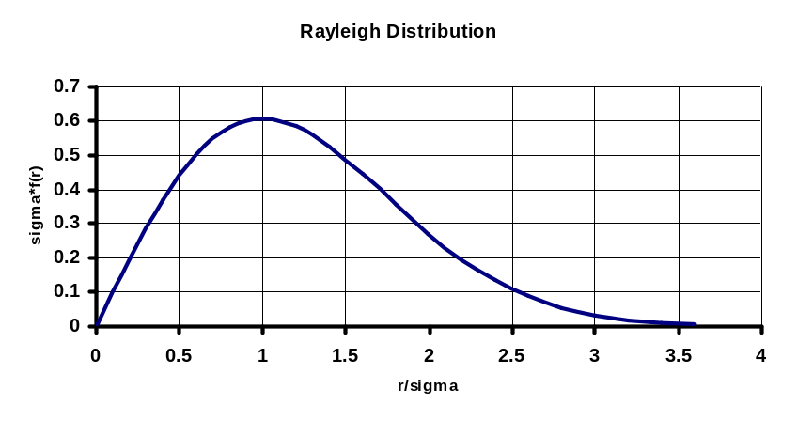
Body Loads
Body loading discussed so far has been for the pitch plane only
But, the body is simultaneously loaded in the yaw plane
  Due to symmetry yaw plane statistics are the same as for the pitch plane
  Keep in mind that pitch plane and yaw plane motions & loads are statistically independent
What’s needed are the composite (pitch + yaw plane) loads, S_{C} & M_{C}
This can best be analyzed in polar
coordinates. If both yaw (y) and pitch (x)
components have the same σ, their
“radius” follows a Rayleigh Distribution
yaw
composite
pitch
r² = x² + y², and σ f(r) = (r/σ) exp(-(r/σ)²/2)
Rayleigh Distribution
yaw
σf(r)
pitch
r/σ

Slide 14
Body Loads, cont’d
If our marching solutions for shear force and bending moment were based on σ_{α} then the result will be the pitch plane standard deviations in shear force and bending moment as a function of body station
More notation
  σ_{SP}(x_{i}) = standard deviation in pitch plane shear force at station x_{i}
  σ_{MP}(xi) = standard deviation in pitch plane bending moment at station x_{i}
  CDL (x_{i})= Composite design load (shear force or bending moment) at body station x_{i}
  Pr = Probability that CDL loads will not be exceeded in flight
Since both pitch and yaw loading standard deviations are the same, the Rayleigh distribution can be integrated and solved for the probability
CDL(x_{i}) = (σ_{SP}(x_{i}) or σ_{MP}(xi)) √ - 2 log (1 – Pr)

Slide 15
Fin Loads
Fins are loaded in one plane only
But, a mean cant angle causes a mean roll rate that induces mean loading on fins
And, because fin load statistics are one-dimensional gaussian, there is no simple formula that relates mean and standard deviation to the probability that a load will be exceeded
  A relationship does exist, but is numerical in nature
  Implemented in BENDIT

Slide 16
Axial Loads
Two sources of axial load
  Acceleration under thrust and drogue parachute deployment
  Both are deterministic
Motor thrust is carried to body
at the forward closure
Elements ahead of forward
closure are in compression;
those aft of it are in tension
Thrust
Motor forward closure
Aft bulkhead
Drogue attached to aft bulkhead
Inflates before slowing the rocket
Elements ahead of aft bulkhead
are all in tension
Drogue drag

Slide 17
Summary
Don’t be afraid to ask your questions or to seek further understanding
Home phone (with answering machine) (310) 839-6956
Email houltight@aol.com
Address 4363 Motor Ave., Culver City, CA 90232
The only dumb question is the one you were too scared to ask

